Slide 1
Enthusiasm for Fusion
Advices for young researchers
Juan Knaster
Deputy Head of ITER Programme Department
FuseNet PhD Event
8 November 2018

Slide 2


Slide 3
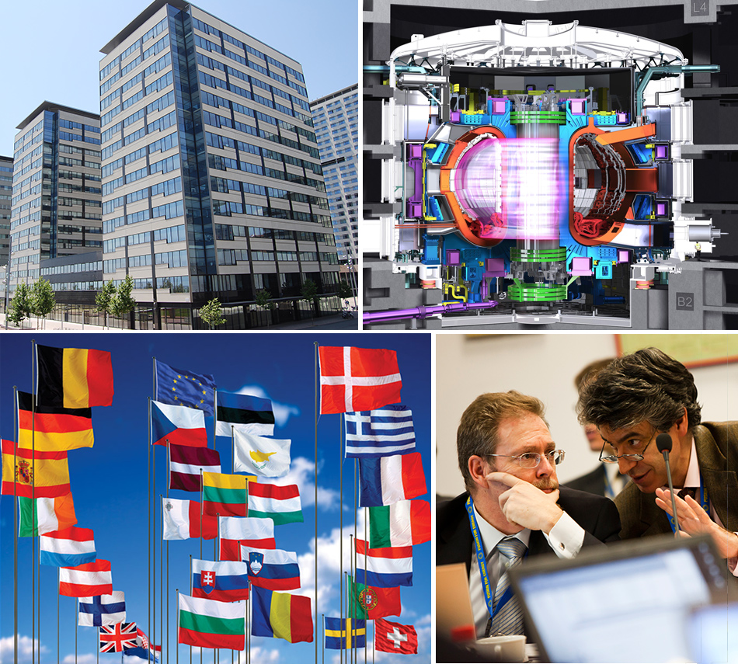
What is F4E?
  The European Union organisation for
  the development of fusion energy
  European Joint Undertaking set up by the European Council in 2007 for 35 years
  Governed by 29 states (EU28 + CH) and the European Commission
  Headquarters: Barcelona, Spain
  Offices: Cadarache, France Garching, Germany
  Rokkasho, Japan
  Staff: 460 employees
  Budget: €6.6 billion (2007-2020)
Notes:
Let me start by introducing F4E and the elaborate on its main responsibilities
The European Union organisation for the development of fusion energy
European Joint Undertaking set up by the European Council in 2007 for 35 years
Governed by 29 states (EU28 + CH) and the European Commission
Headquarters: Barcelona, Spain
Offices: Cadarache, France
Garching, Germany
Rokkasho, Japan
Staff: more than 440 employees
2007-2020: approximately € 6 billion for ITER

Slide 4
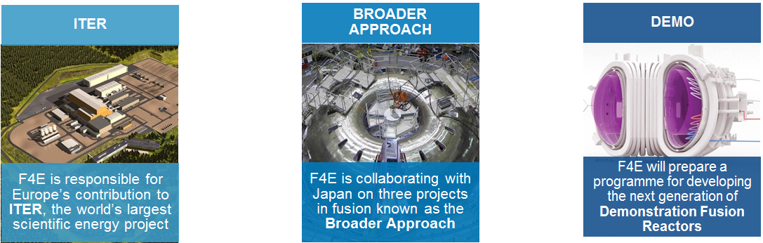
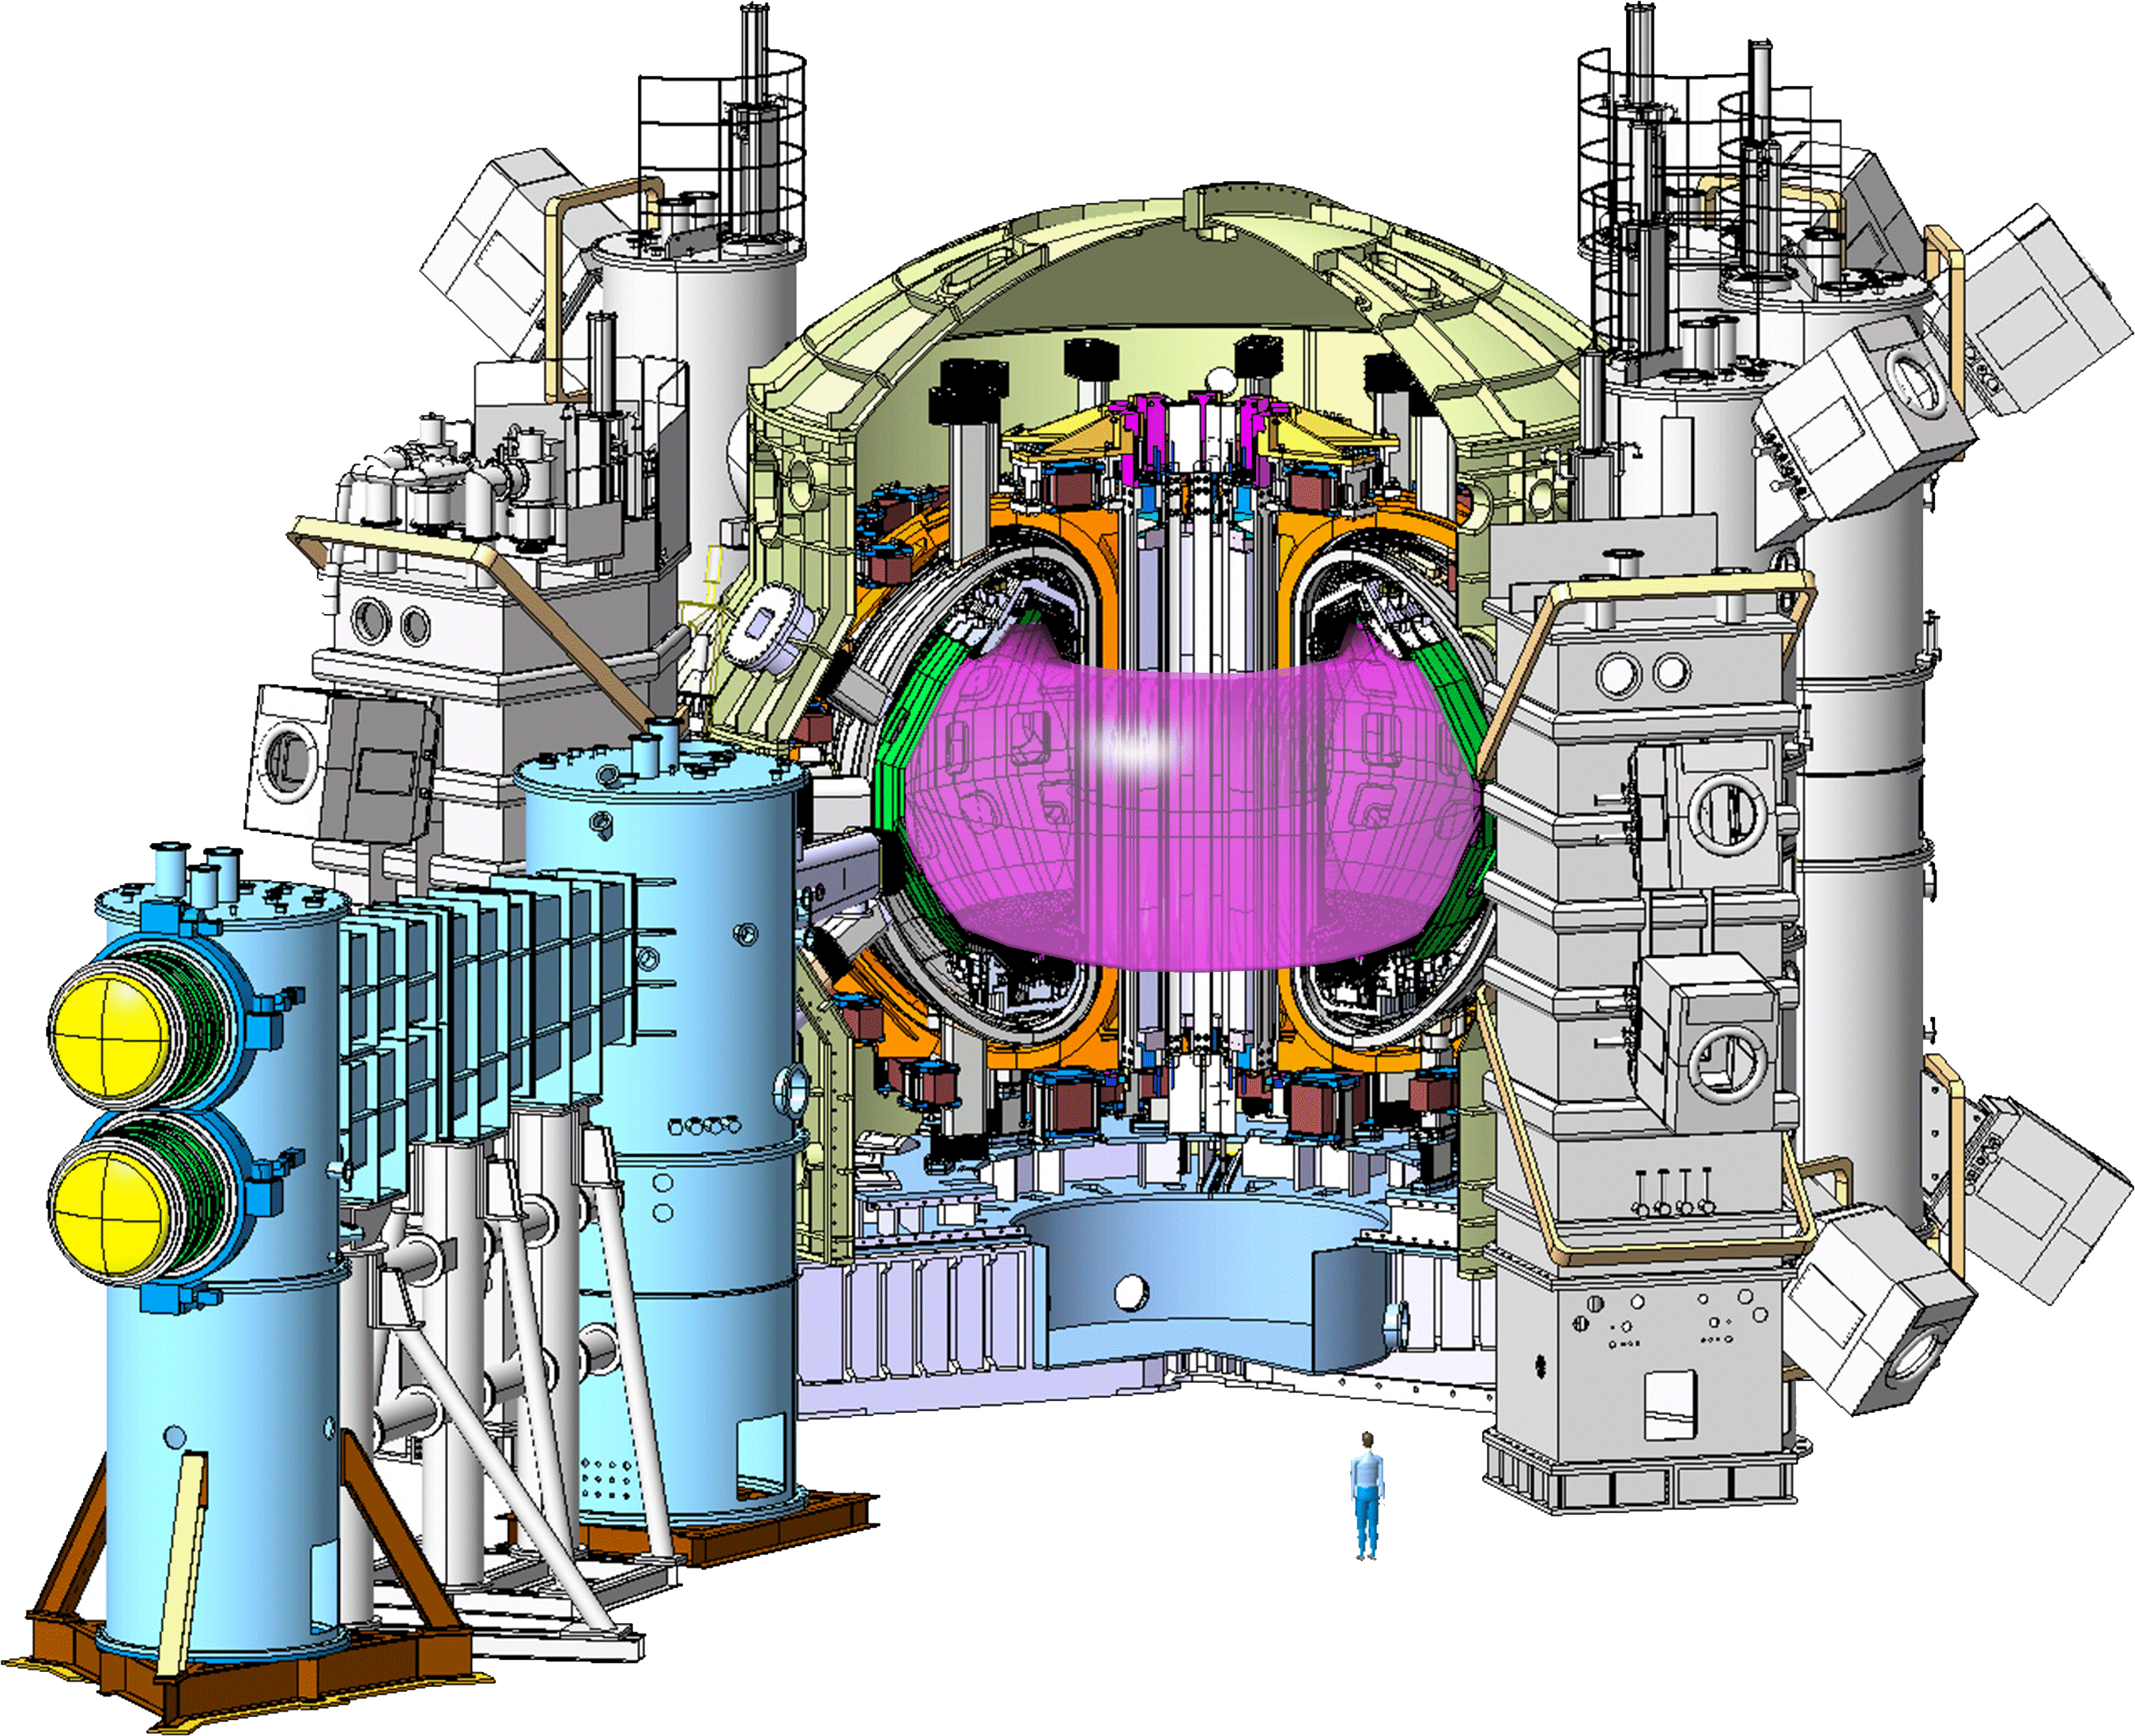
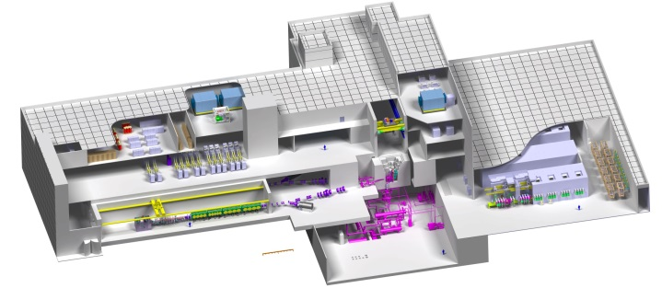
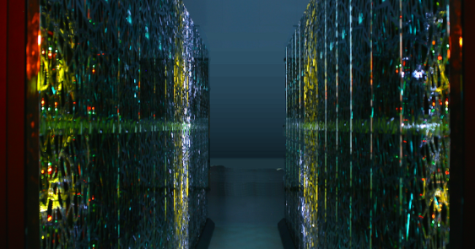
F4E is following 3 programs
JT-60SA
IFMIF
IFERC

Slide 5

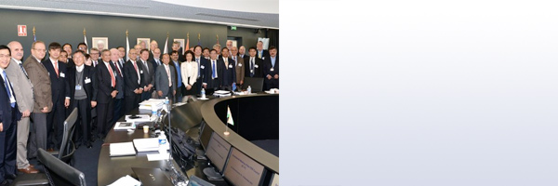






Governance of ITER and F4E is complex
EURATOM
European
Commission
ITER Council
Other
ITER Parties
F4E
Governing
Board
ITER
International
Organization
EU-DA
Other
DAs
Industry
Research
Institutes
Notes:
Understanding the ITER governance is essential in order to figure out who does what and in what sequence

Slide 6
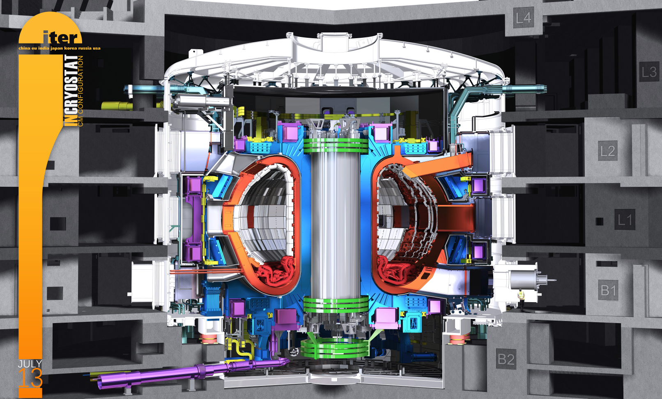
European contribution to ITER
Pre-Compression Rings
PoloidalMagnets
Diagnostics
Toroidal
Magnets
Neutral Beam
EC/IC
Heating
Vacuum
Vessel
Divertor
First Wall
Panels
Cryopumps

Slide 7

Why was I so puzzled?

Slide 8
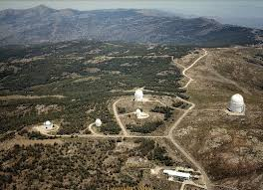
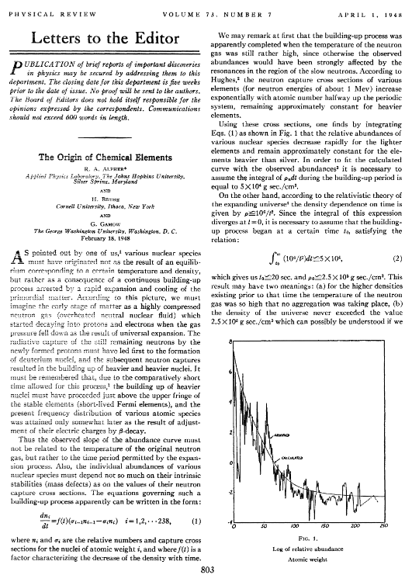

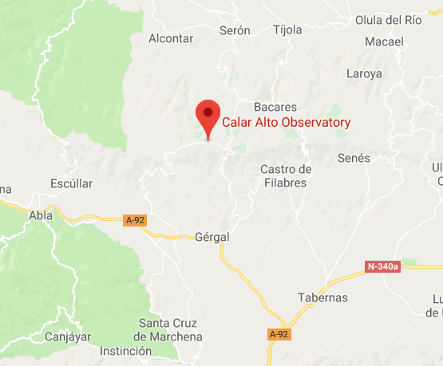
Driven by fusion world since teenager times
Calar Alto Observatory
Αβγ-paper
late 80s

Slide 9
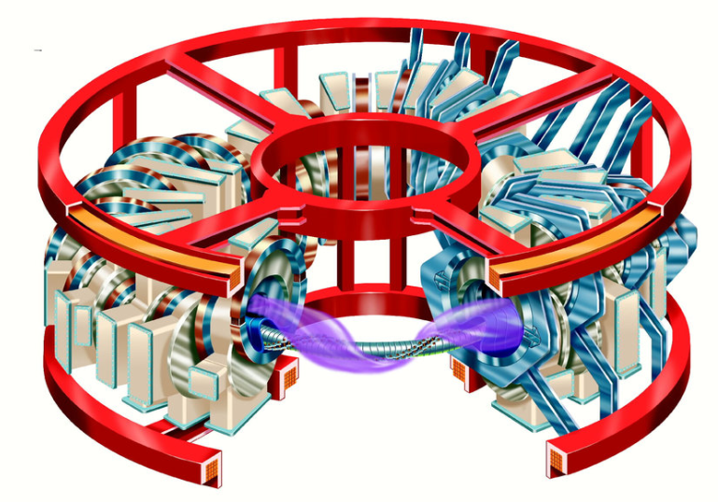
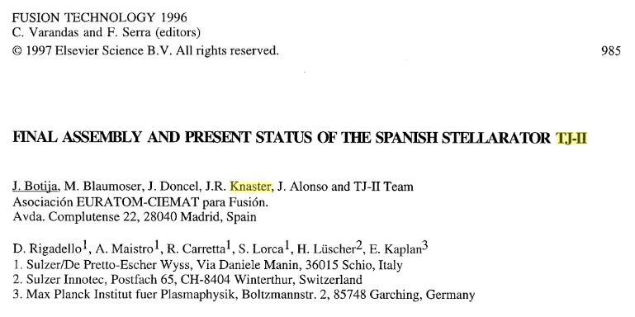

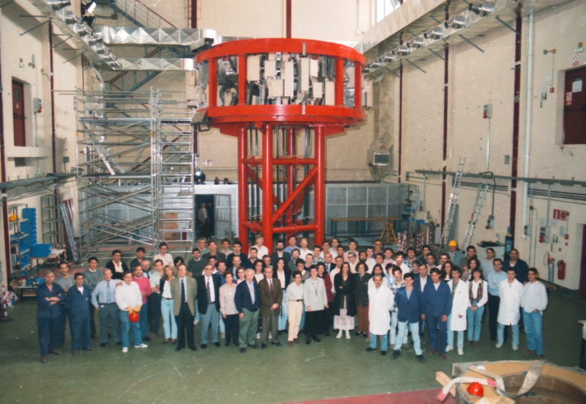
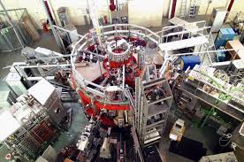
In Fusion right after university
Joined
Middle 90s

Slide 10
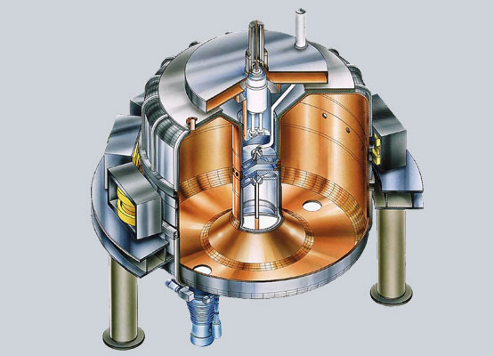
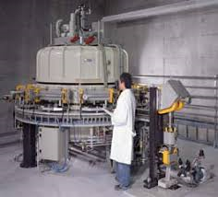
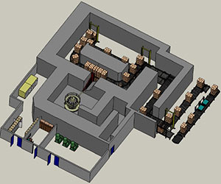
Moved to private industry
Late 90s
almost two years
Production Manager
in a factory near Madrid
10 mA of e⁻ at 10 MeV
sterilizing medical products at 25 kGy
Late 90s

Slide 11
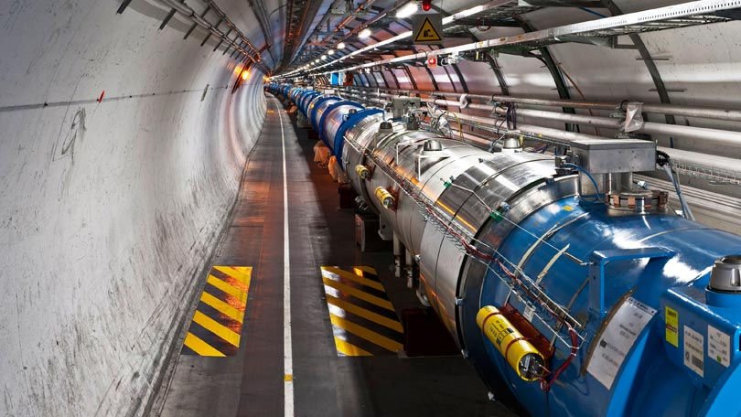
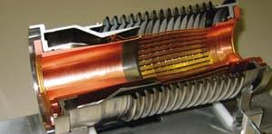
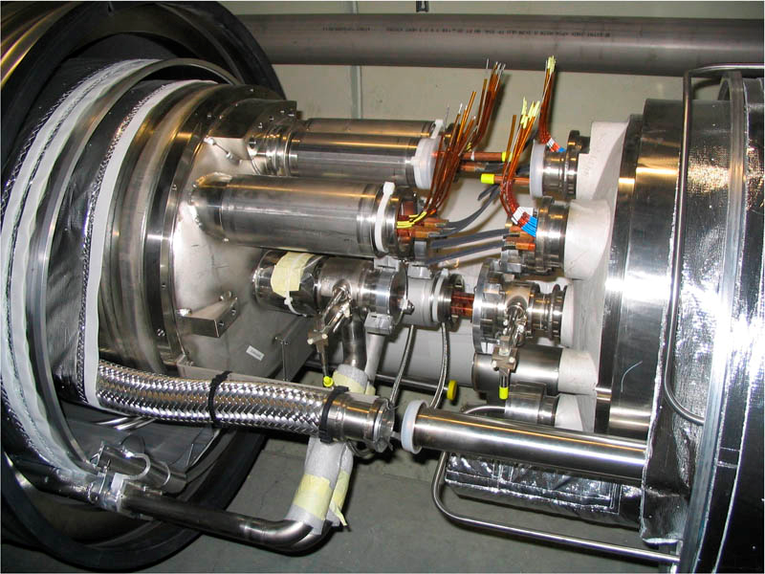
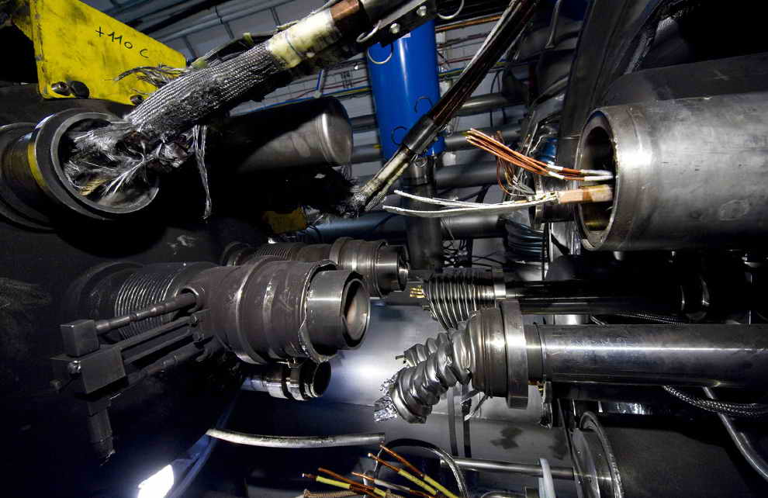

Back in science
1999 till 2005
As mechanical engineer
LHC Division/Vacuum Group

Slide 12
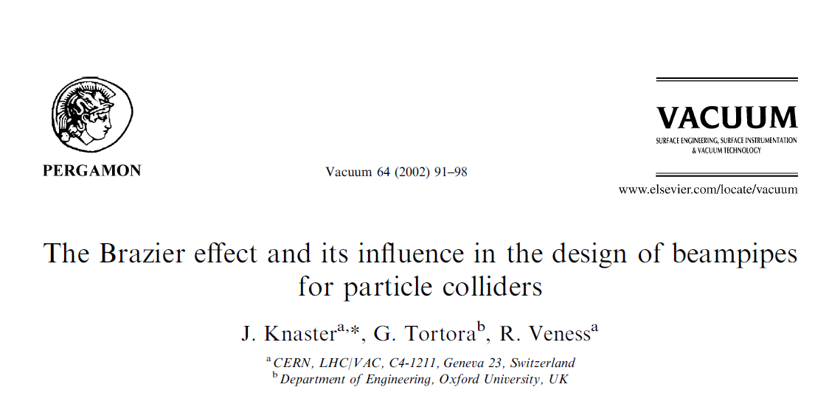
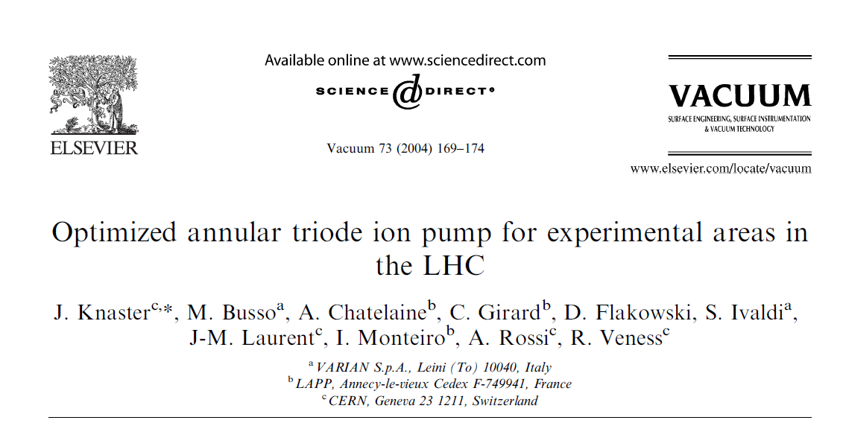
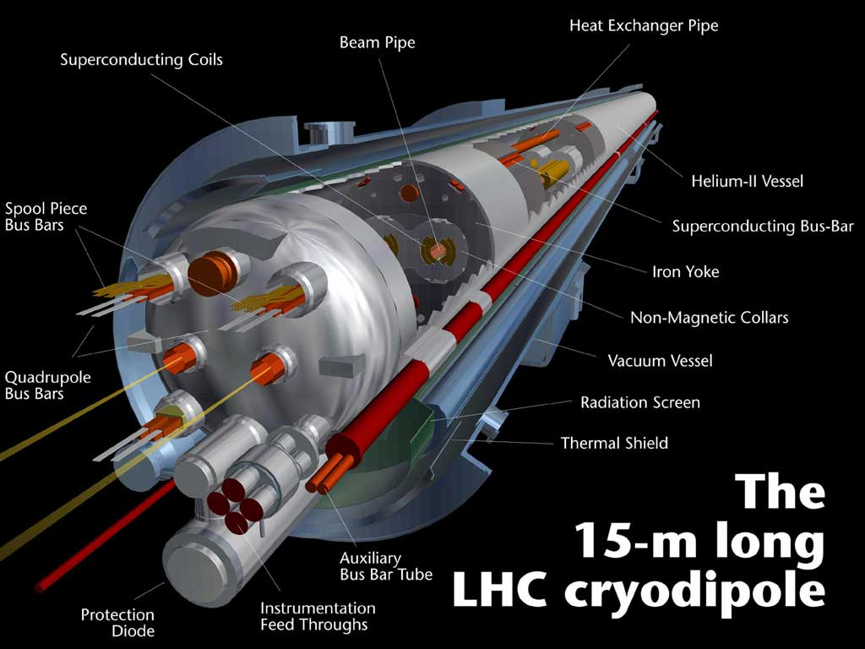
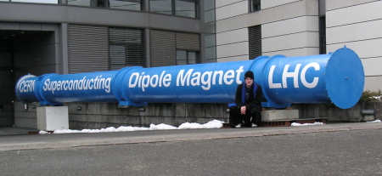
In vacuum but dreaming with SC magnets

Slide 13
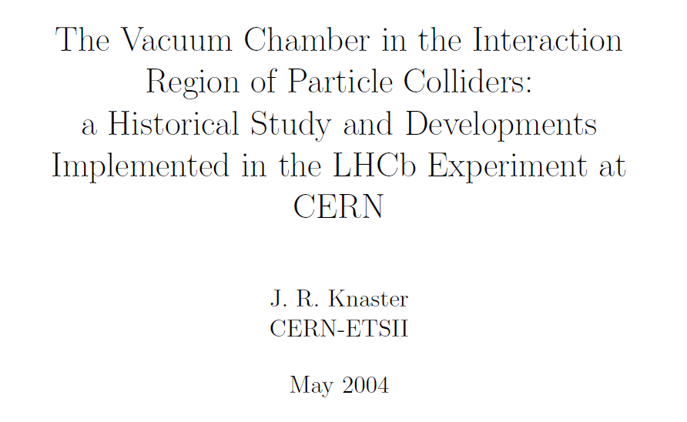
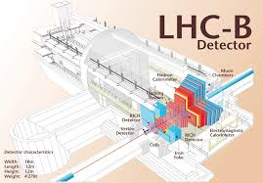

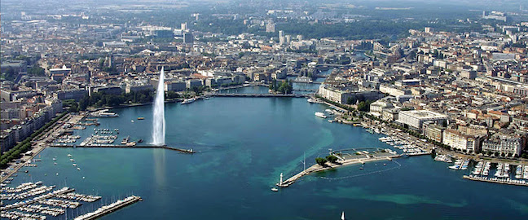
CERN-THESIS-2005-009

Slide 14
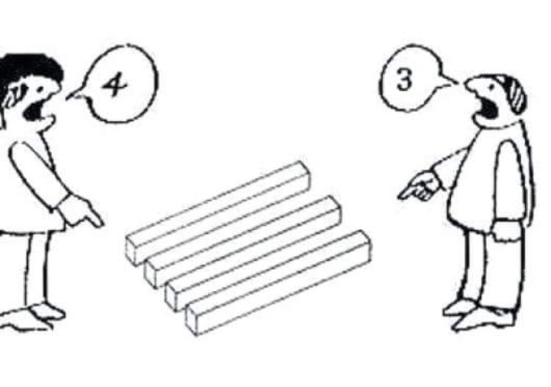
Advices I
Harmonize your personal and your professional life
Make friends – build network
To convey a message, there are two factors
  How you say
  When you say
Learn to listen to other’s opinions
Follow your dreams

Slide 15
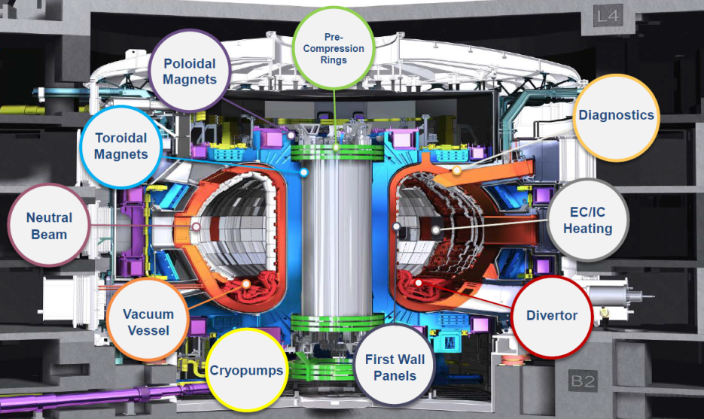
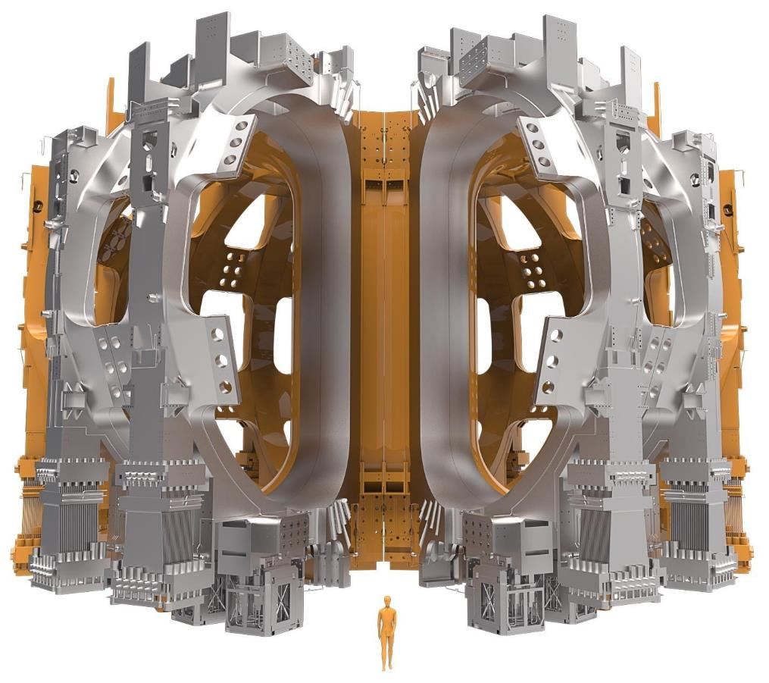
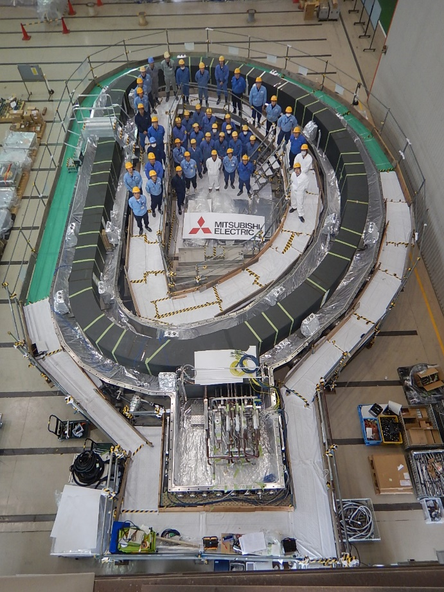
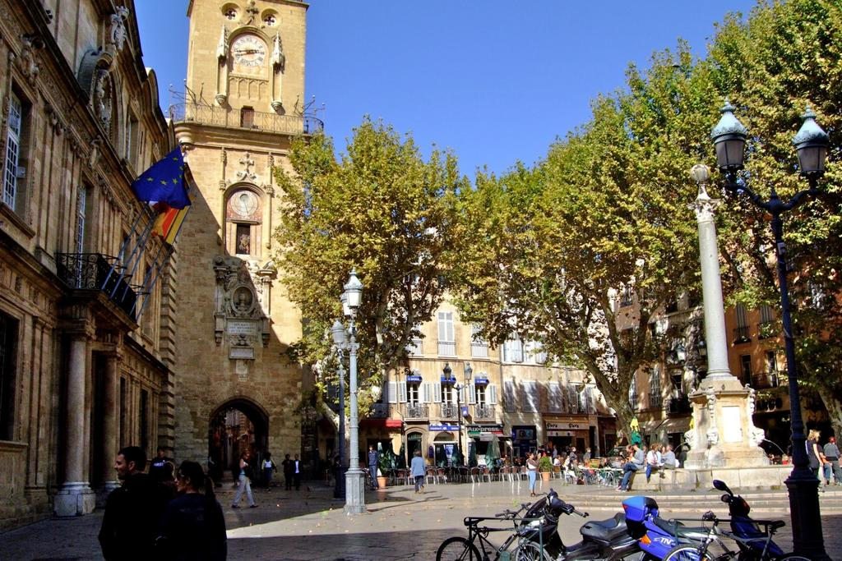
Back in Fusion world – ITER’s magnets
End of 2005 onwards…

Slide 16
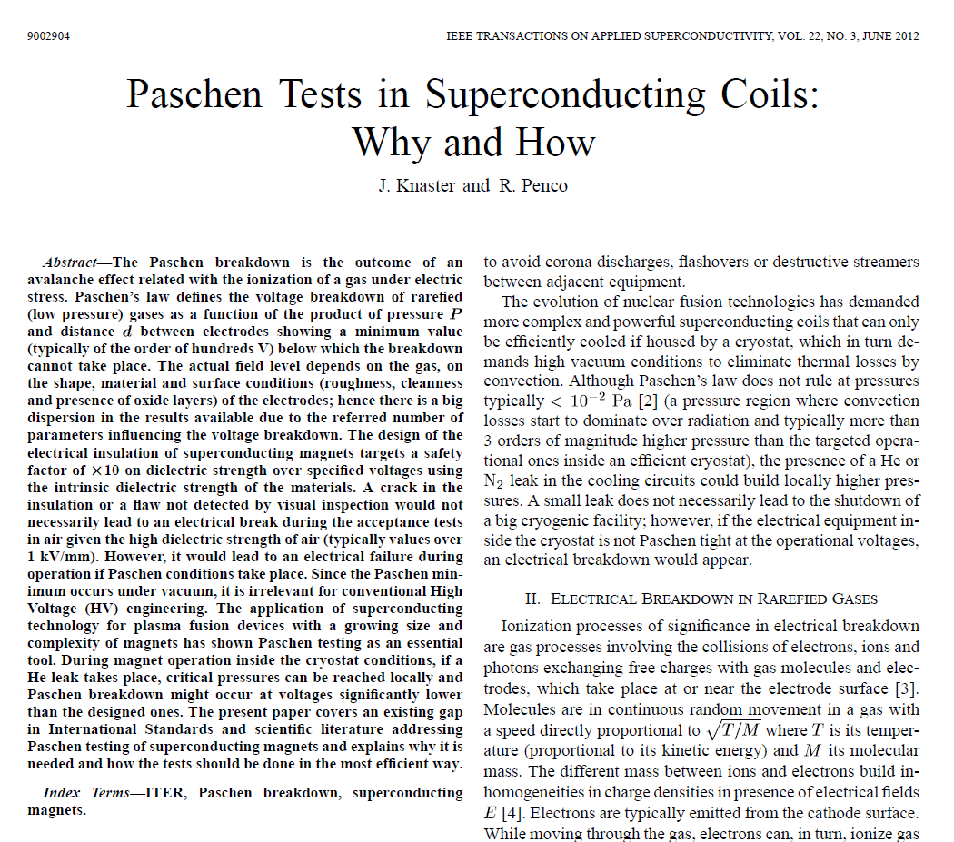
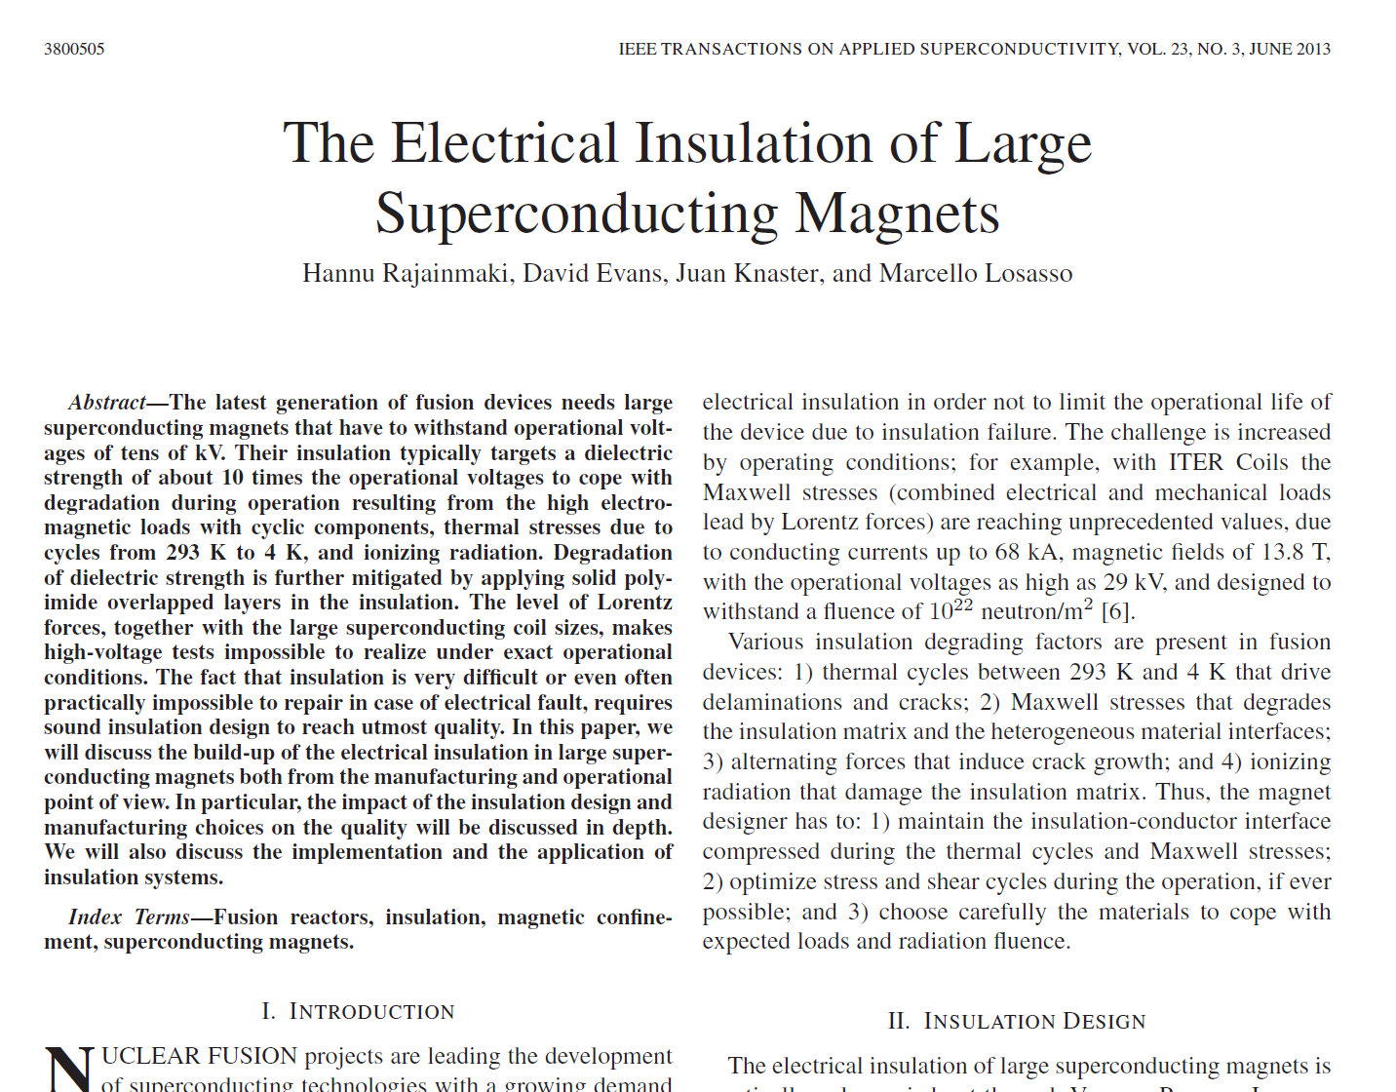
Invited talk in MT2011
Invited talk in ASC2012

Slide 17
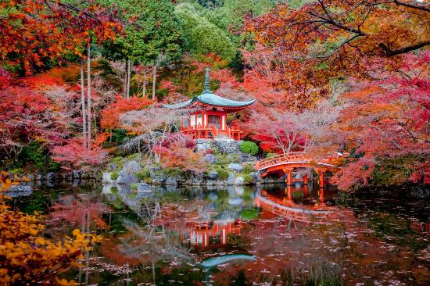
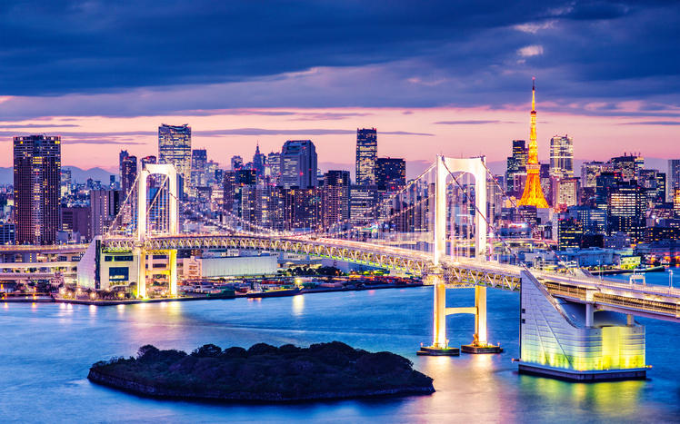
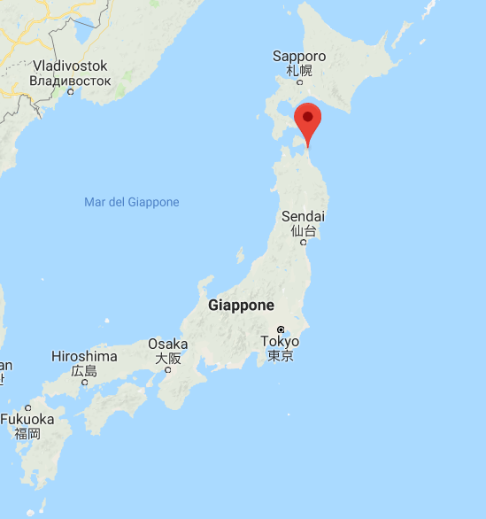
June 2012 – April 20018

Slide 18

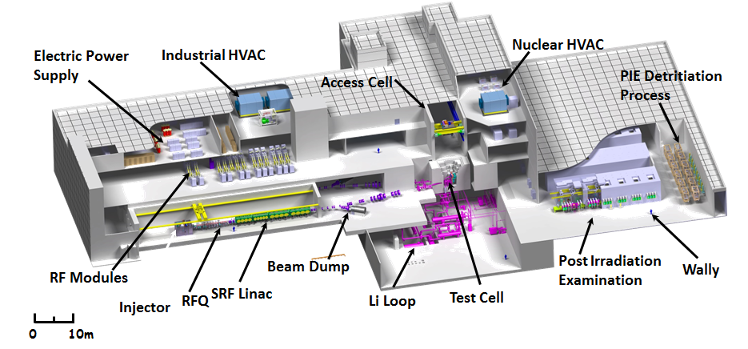
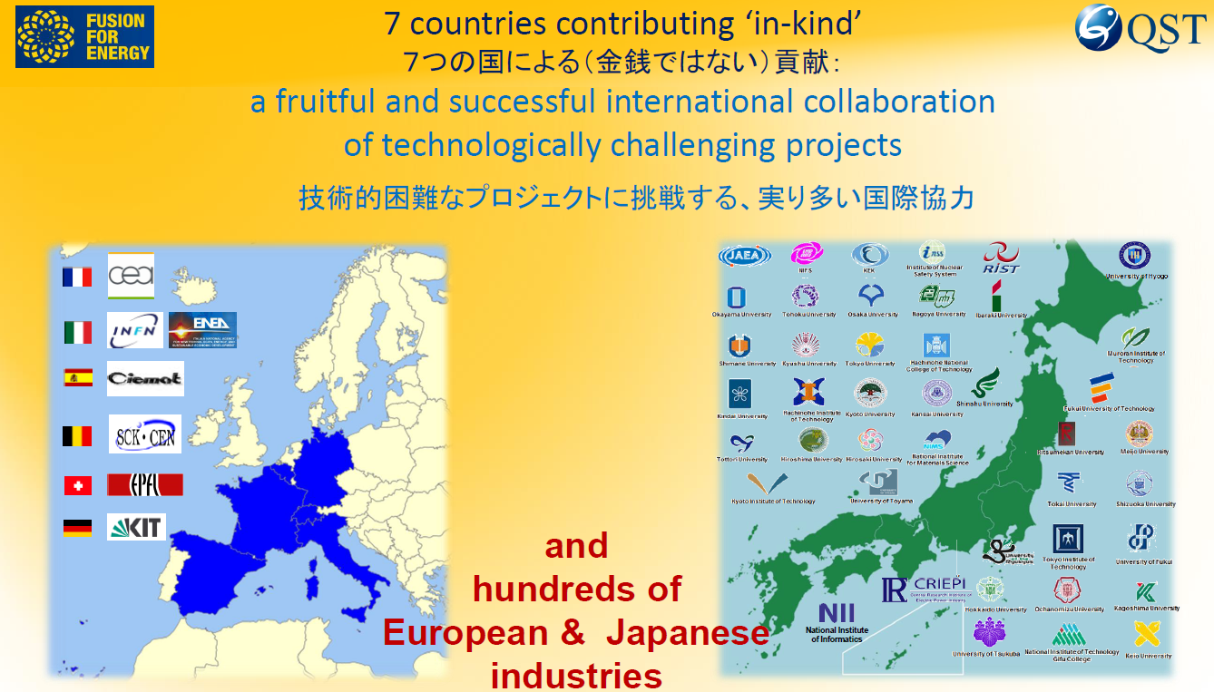
IFMIF/EVEDA
International Fusion Material Irradiation Facility
Engineering Validation and Engineering Design Activities

Slide 19
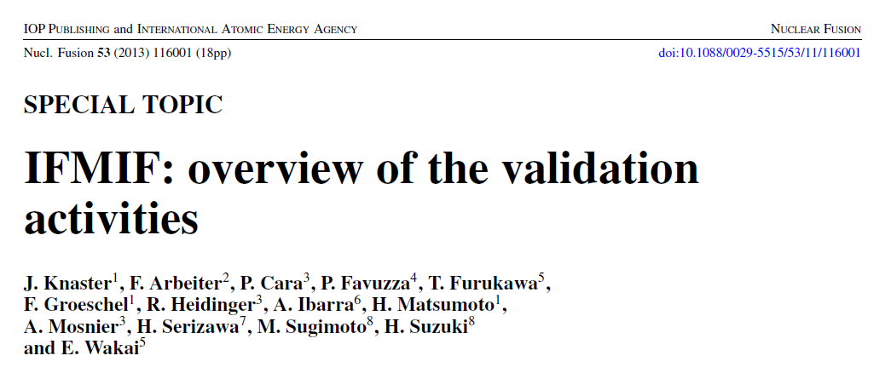
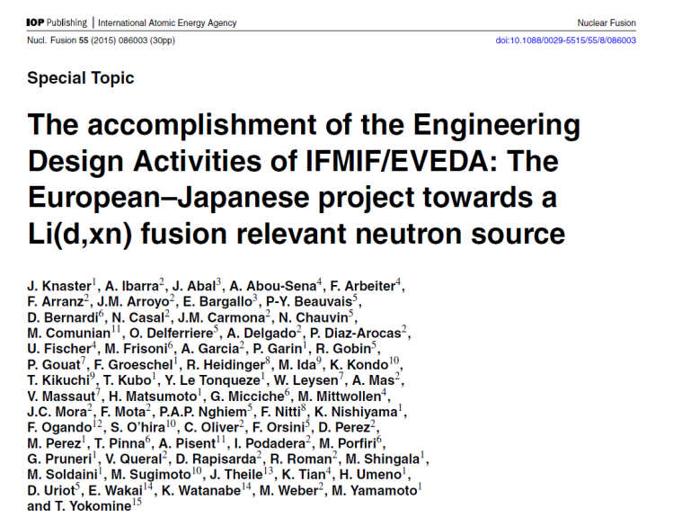
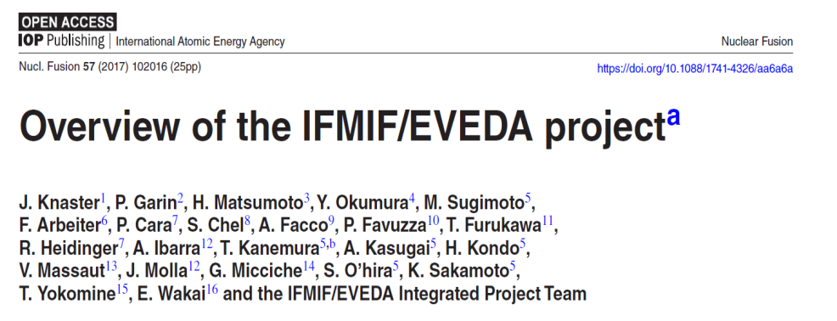
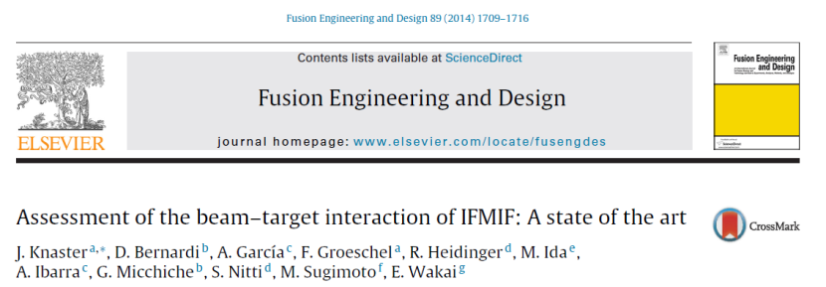
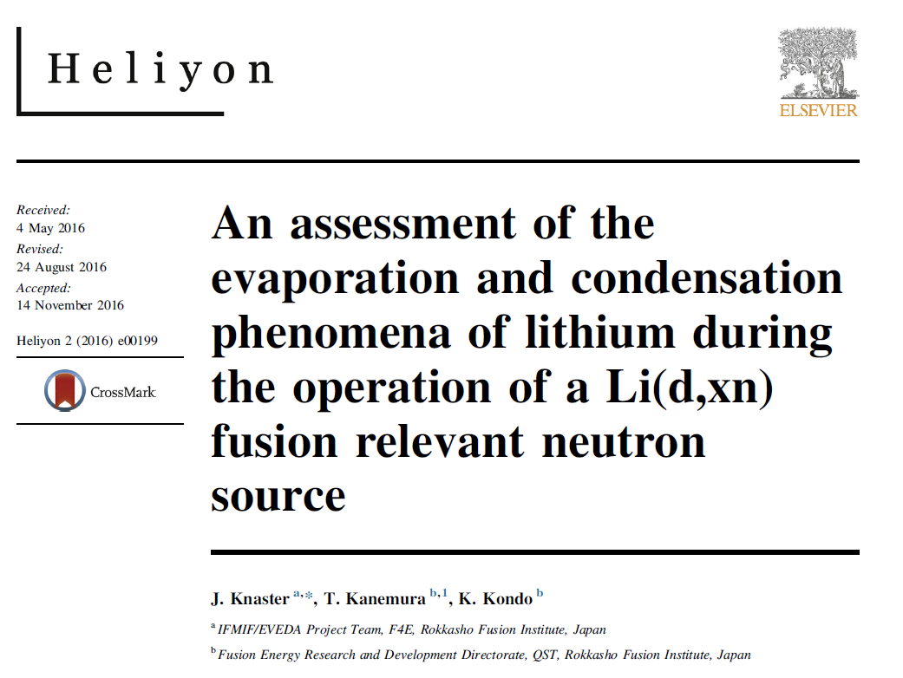
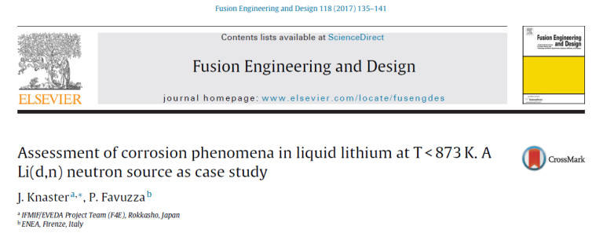
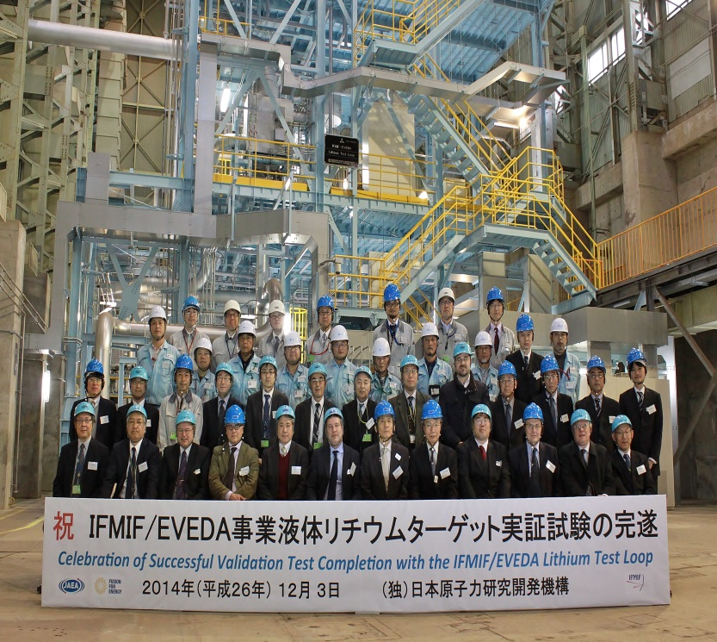
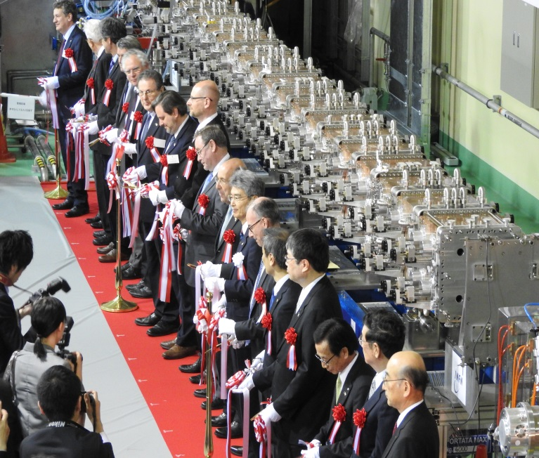
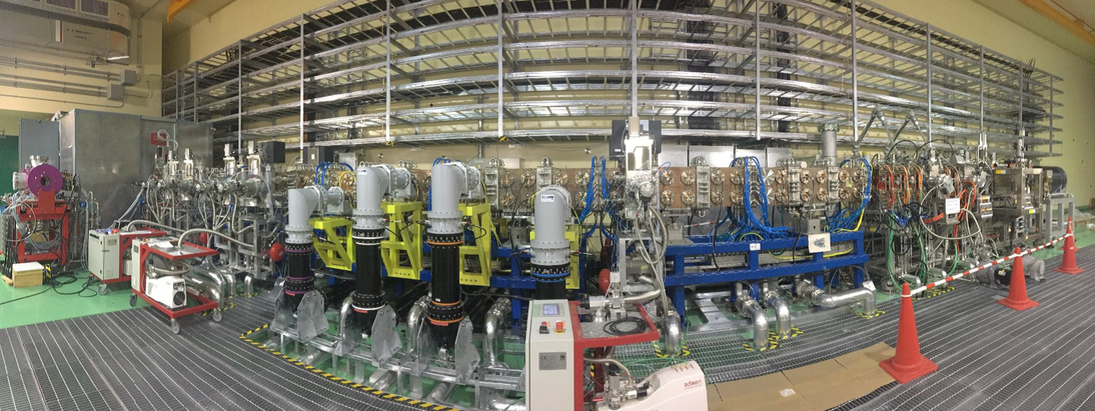

Slide 20
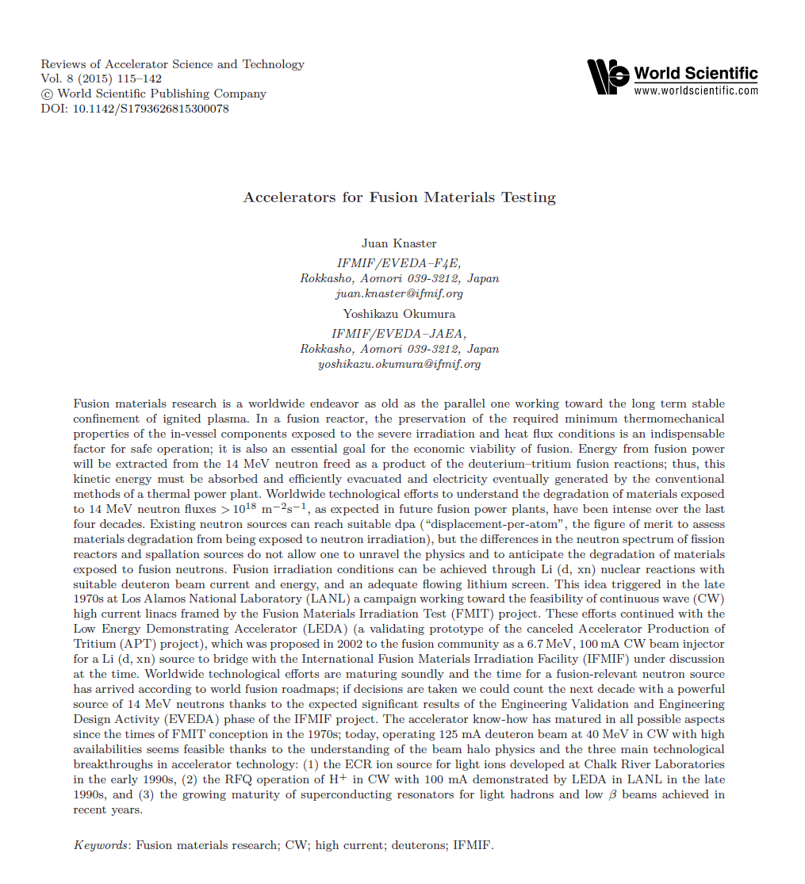

Study hard - Three years later…

Slide 21
Advices II
Align with the corporative strategy
Study, enjoy learning
Ask questions, don’t be shy
Be honest, be frank… never lie
Be resilient
Be generous
Be perseverant… believe in your dreams

Slide 22

April 20018 onwards…

Slide 23


All stars are fusion reactors
by gravitational confinement
We aim to bring a star to earth
Is it not a beautiful dream?

Slide 24
Advices III
Be humble
Arrogance is the pride of dulls
juan.knaster@f4e.europa.eu
juan.knaster@iter.org

